Slide 1
LASERS
Kamalakanta Satpathy

Slide 2
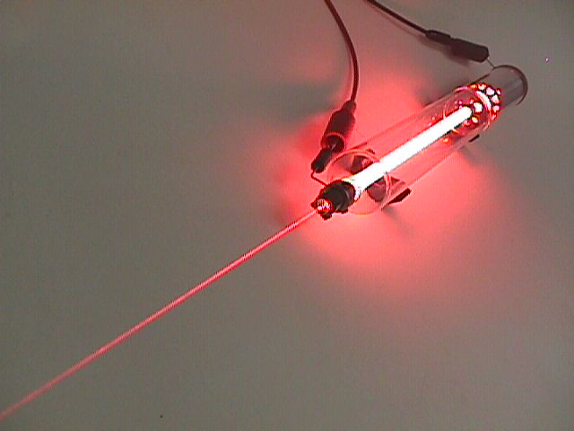

Slide 3

Incandescent vs. Laser Light
Many wavelengths
Multidirectional
Incoherent
Monochromatic
Directional
Coherent

Slide 4
What is LASER????
Light Amplification by Stimulated Emission of
Radiation
A device that produces a coherent beam of optical radiation by stimulating electronic, ionic, or molecular transitions to higher energy levels.
When they return to lower energy levels by stimulated emission, they emit energy.

Slide 5
Basic concepts for a laser
Absorption
Spontaneous Emission
Stimulated Emission
Population inversion

Slide 6
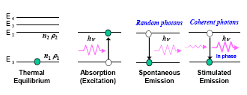
Lasers: Basic Principle Absorption and Radiation Processes

Slide 7
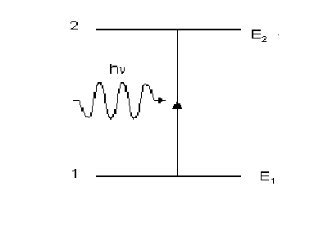
Absorption
An electron in an atom can be excited from an energy level E₁ to a
higher energy level E₂ by absorption:
photon absorption─ hν = E₂ – E₁.

Slide 8
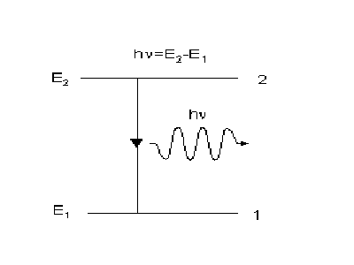
Spontaneous Emission
The atom decays from level 2 to level 1 through the
emission of a photon with the energy hv. It is a completely
random process.

Slide 9
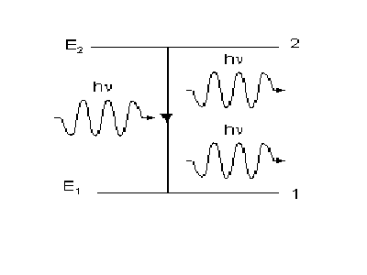
Stimulated Emission
Atoms in an upper energy level can be triggered or stimulated
in phase by an incoming photon of a specific energy.

Slide 10
Stimulated Emission
The stimulated photons have unique properties:
In phase with the incident photon
Same wavelength as the incident photon
Travel in same direction as incident photon

Slide 11
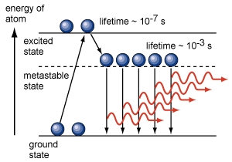
Population Inversion
A state in which a substance has been energized, or excited to specific energy levels.
More atoms or molecules are in a higher excited state.
The process of producing a population inversion is called pumping.
Examples:
→by lamps of appropriate intensity
→by electrical discharge

Slide 12
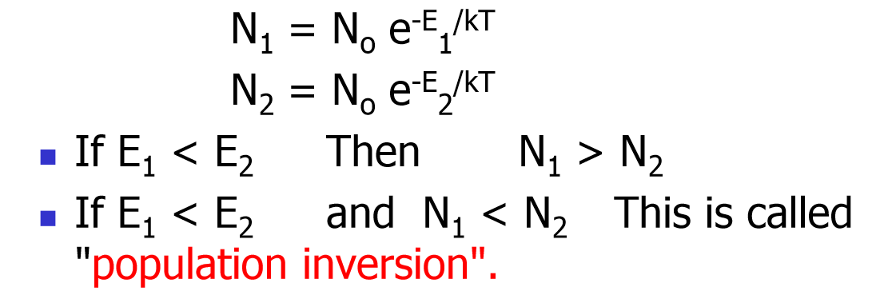
According to Boltzmann’s Statistics, if a sample has a large number of atoms, N₀ at temperature T, then in thermal equilibrium, the number of atoms in energy states E₁ and E₂

Slide 13
Pumping
The method of raising a particle from lower energy state to higher energy state is called pumping.
There are several methods of pumping a laser:
(a) Optical pumping
(b) Electric Discharge
(c) Inelastic atom-atom collision
(d) Chemical reactions

Slide 14
Metastable states
An atom or molecule in an excited state remains there for a certain time called the lifetime of that state, before making a transition to a lower state. Most of the states have a short lifetime (~10⁻⁸ s). However, some energy states have very long lifetime ~10⁻³ s or higher. Energy states with such long life times are called meta-stable states. Atom reaches the meta stable state can remain there for longer time period. So the number of atom increases in the meta stable state. And when these atoms come back to the original ground level it emits laser beam.
WHY WE NEED?

Slide 15
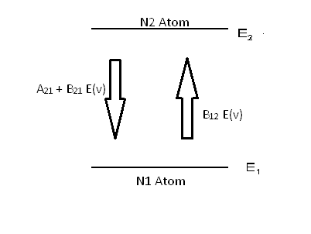
Einstein’s Coefficients

Slide 16
Spontaneous emission
A₂₁ :- correspond to spontaneous emission probability per unit time.
This particular emission can occur without the presence of external field E(v)

Slide 17
Stimulated Emission
B₂₁ :- correspond to stimulated emission probability per unit time
This type of emission can occur in presence of external field E(v) only

Slide 18
Stimulated Absorption
B₁₂ :- correspond to stimulated absorption probability per unit time
This type of absorption can occur in presence of external field E(v) only

Slide 19
Total Emission Probability
Spontaneous Emission + Stimulated Emission
A₂₁ + B₂₁ E(v)
Number of atoms that can jump from level E2 to E1 is

Slide 20
Total Absorption Probability

Slide 21
Equilibrium condition
In case of energy states the number of electron absorbed and emitted should be equal or the rate of change of numbers of atoms in two states should be equal.

Slide 22
The rate of change of atoms in E₂
It can be given by differentiation
(probability)
or

Slide 23
At Equilibrium
Then

Slide 24
Emission and absorption are same

Slide 25
Maxwell Boltzman Distribution
In thermal equilibrium

Slide 26
So the equations become
So equation becomes

Slide 27
Planck’s Radiation Law
Planck’s gives the formula that how a gas radiate energy.

Slide 28
Einstein’s Coefficients
Einstein gives a probability that stimulated emission is same as absorption.
Means that if a stimulated absorption can occur then there is same probability that stimulated emission can occur.

Slide 29
After comparing with Planck’s Radiation Law
and

Slide 30
Conclusions
Stimulated emission have same probability as stimulated absorption.
Ratio between spontaneous and stimulated emission varies with v³
All we need is to calculate one of the probability to find others.

Slide 31
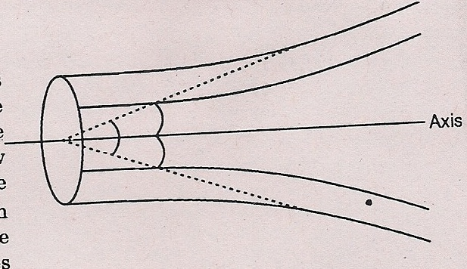
Characteristics of Laser Beam
High directionality:
Directionality is the characteristic of laser light that causes it to travel in a single direction with a narrow cone of divergence. It is defined in terms of divergence angle.
Divergence angle is twice the angle made by the outer edge with the axis of the beam.
The angular spread of beam on one side of the axis :

Slide 32
High Intensity
The intensity of light is defined as the energy passing per unit area per
second through a point normal to the direction of flow. For a spherical
source with output power P , intensity at a point distant r from the source
is given as:
Laser beam is highly intense because it emits light as a narrow beam and
intensity remains high even at large distance from the source.

Slide 33
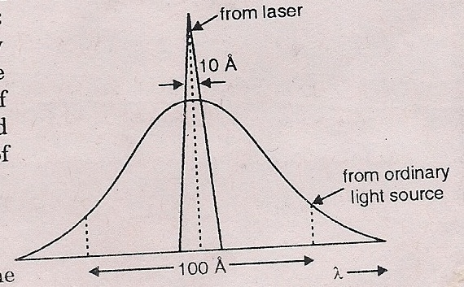
Extraordinary Monochromacity
If ∆ν is the frequency of a spectral line of frequency ν₀then the degree of
monochromacity is defined as:
ε=∆ν/ν₀
Smaller is the value of ε, higher is the monochromacity of light.
For laser source ε=10⁻¹² while for ordinary source ε≈10⁻⁵

Slide 34
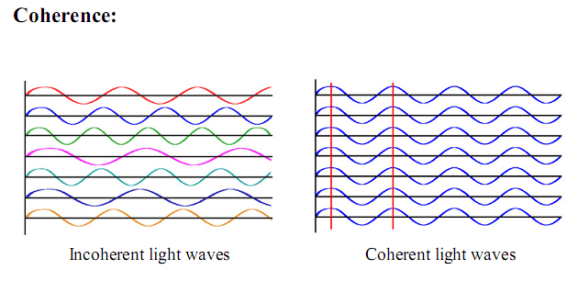
High Coherence
Degree of coherence is the measure of phase correlation in the radiation field at different locations and different time.
Incoherent
Coherent

Slide 35
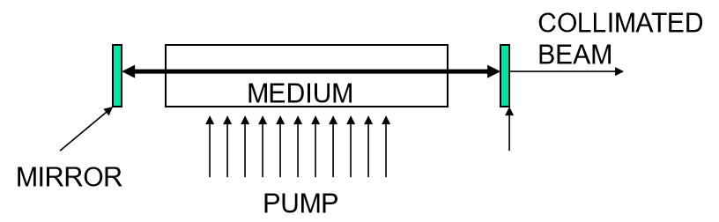
Basic Principle Needed For Laser
To generate a Laser beam, three process must be satisfied:
Population Inversion
Stimulated Emission
Pumping Source

Slide 36
THANKS

